Slide 1
Flat Cable Harness for Space Launcher Applications
5th Space Passive Component Days (SPCD), International Symposium
15-18 October 2024
ESA/ESTEC, Noordwijk, The Netherlands
Presenter : Florent Todeschini – ArianeGroup (Les Mureaux, FRANCE)
Jesús Aspas Puértolas, Bruno Thomas, Nicolas Maisonnave , Joost Van Tooren,
Stéphane Hermant , Emilien Fournaise , Gilles Rouchaud ,
Léo A. Farhat, Joaquín J. Jiménez Carreira.

Slide 2
INTRODUCTION
PART 1: ANALYSIS OF THE SPECIFICATION, IDENTIFICATION OF USE CASES AND OVERVIEW OF AVAILABLE TECHNOLOGIES: TRADE-OFF
PART 2: LAUNCHER HARNESS DESIGN
PART 3: MOCKUP MANUFACTURING AND TEST
CONCLUSIONS AND PERSPECTIVES

Slide 3
INTRODUCTION
WORK PRESENTED HERE HAD:
ESA Support → “IMPROVED DESIGN OF HARNESS FOR LAUNCHER”-EXPRO+
TO EXPLORE HARNESSING SOLUTIONS FOR SPACE USE THAT MAY BRING RELEVANT MASS, COST, VOLUME and AIT GAINS.
-

Slide 4
INTROduction - Working LOGIC
TRADE-OFF OF NEW SOLUTION FOR HARNESS ON LAUNCHERS:
Identification of harness technology
Guarantee the harness efficient considering:
        Environment constraints (thermal, mechanical, EM),
        RAMS,
        AIT optimization
  => With the objective to reduce Mass/Cost/Volume features
-

Slide 5
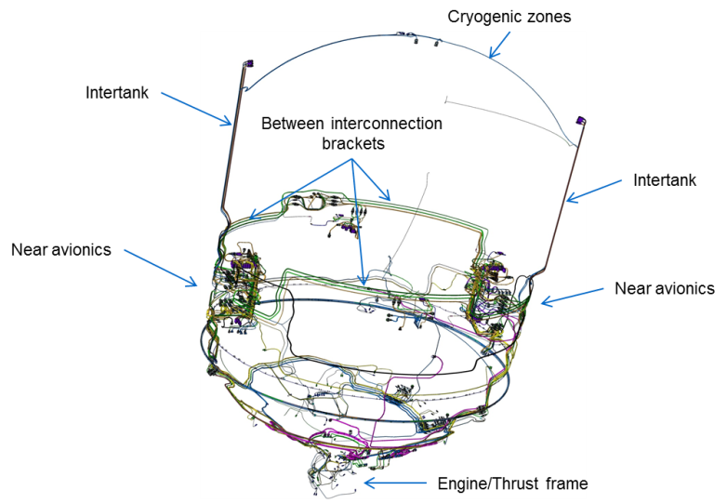
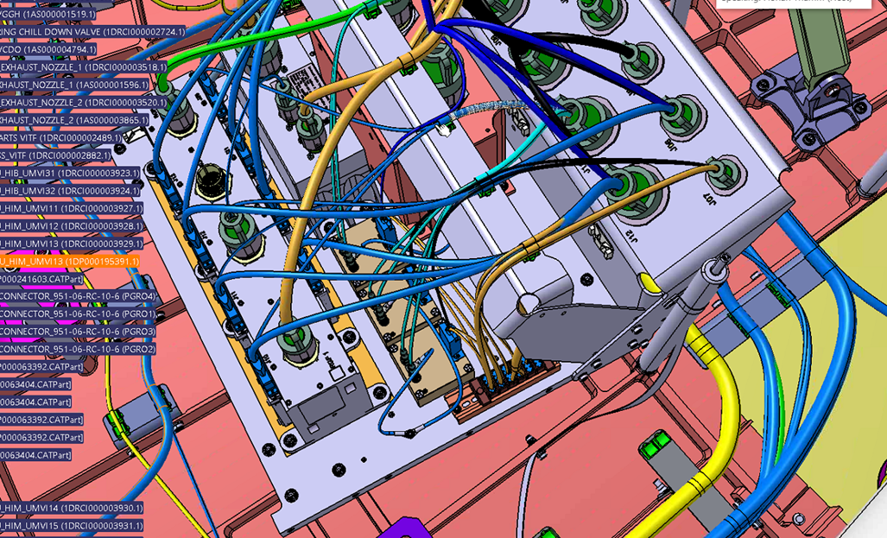
PART1: APPLICATIONS identified…LAUNCHER
200 kg
400 kg
140
Harness
Cost
Installed
Cost
10 km
Harness
mass
40% of total harness budget
60 % of total harness budget
Number
Harness
Installed Mass (include brackets, etc.)
Conductors
length
-

Slide 6
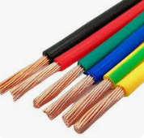
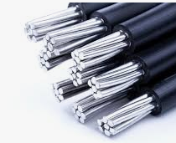
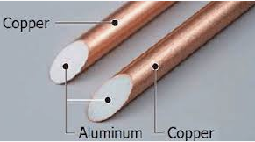
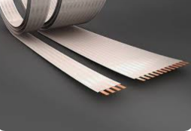
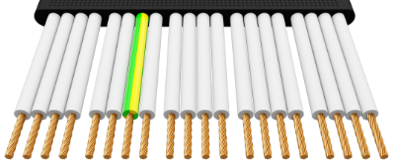
PART1 : TRADE-OFF CONCLUSION
Installed product | Cost | Mass | Volume allocation | Installation impact /Lead time
RWC Standard (Round Wire Cable)
RWC Aluminum
RWC Hybrid
FCC (Flat Conductor Cable)
FFC (Flat Flexible Cable)
RWC Standard RWC Aluminium RWC Hybrid FCC FFC
-

Slide 7
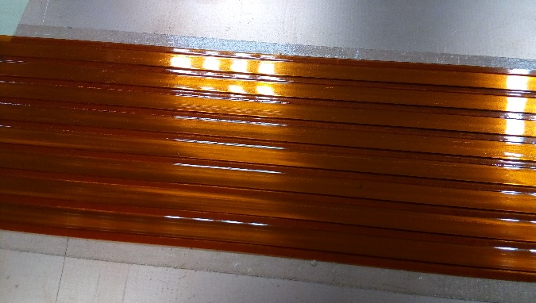
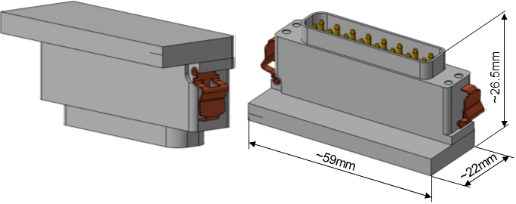
PART 1: BASIC BRICKS
Flat Conductor Cable
8 conductors Pitch of 5 mm,
AWG 18-22
Versatys prototype
two flat cable conductors, 16 points,
AWG 20 contact
-

Slide 8
PART 2: Harness architecture choice
EMC Class N
EMC Class i
(Signal/Data/Command)
Insulation
Electrical conductort
EMC Class 1
(Power)
(+)
(+)
Shielding
(-)
(-)
Spacecraft Structure
Installation Footprint
-

Slide 9
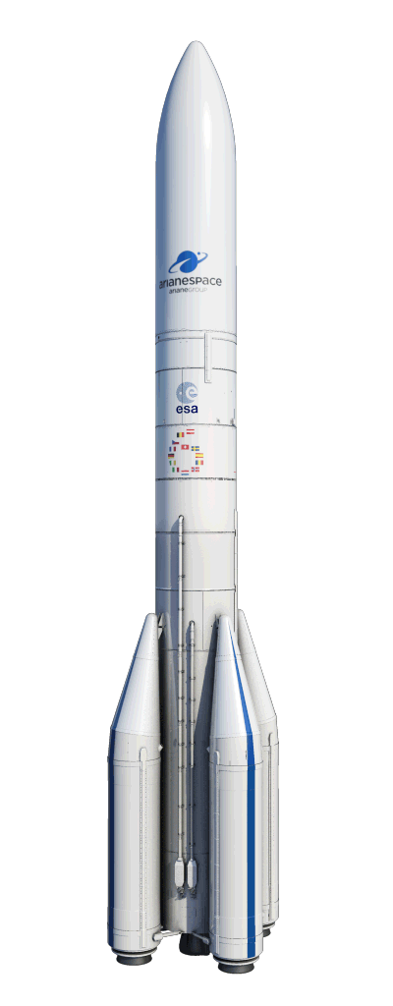
PART 2: SPECIFIC USE CASES
External Raceway
Internal Intertank
2
1
Avionics Bay
3
-
16/10/2024

Slide 10
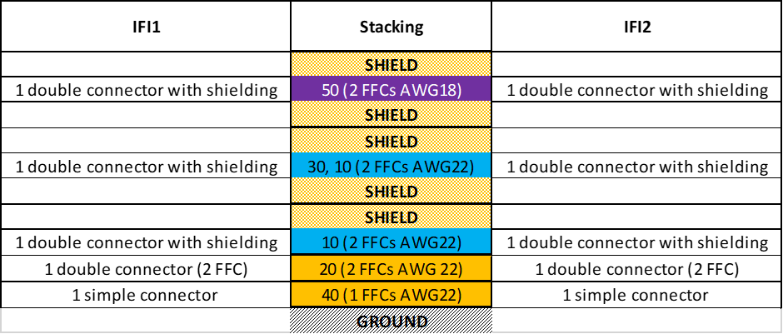
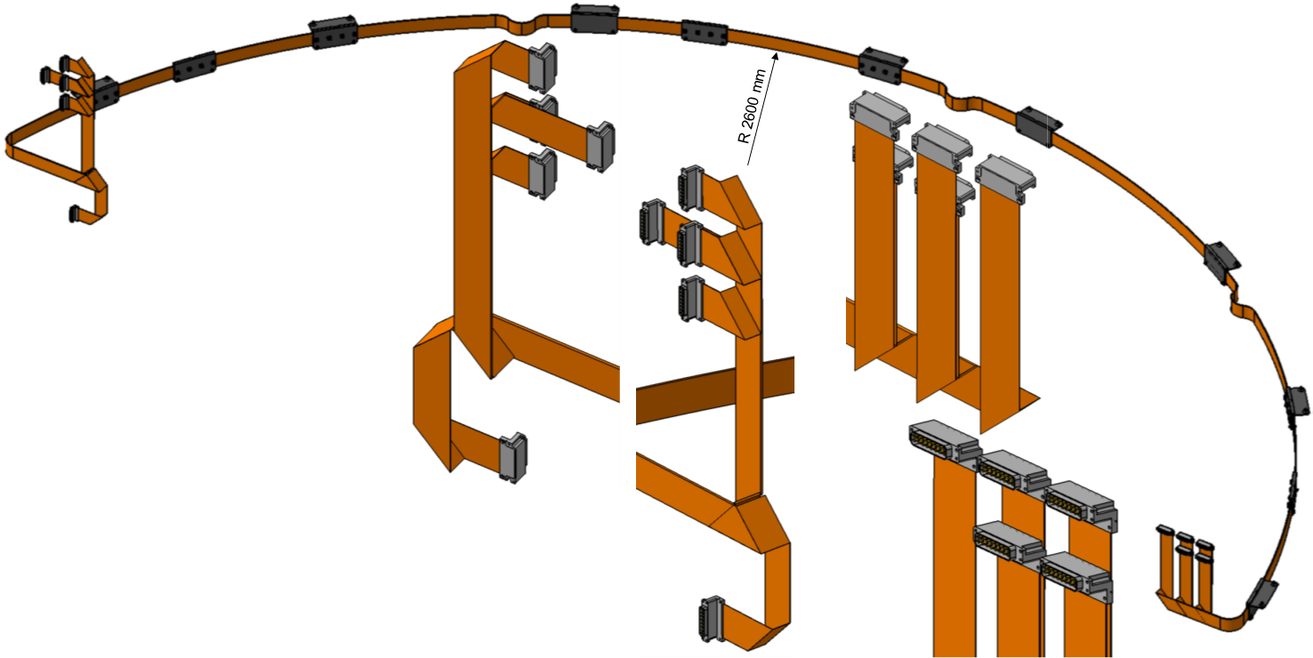
PART 2: INTERTANK Design
-

Slide 11
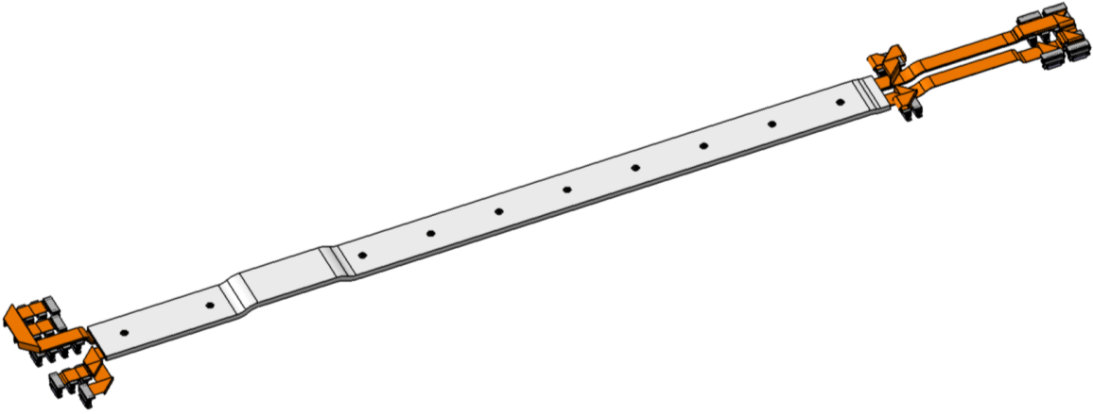
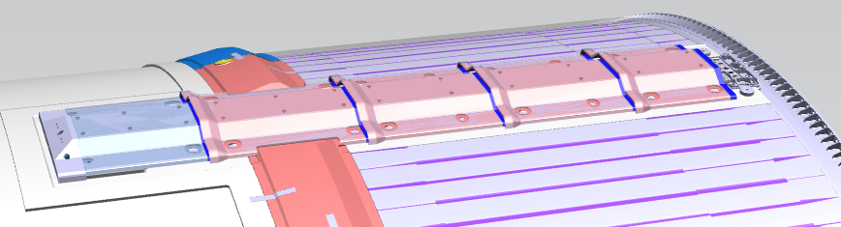
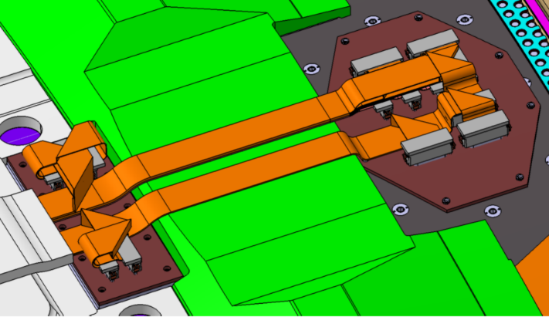
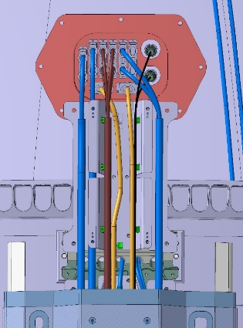
PART 2: EXTERNAL RACEWAY DESIGN
ULPM Raceway
Current solution
-

Slide 12
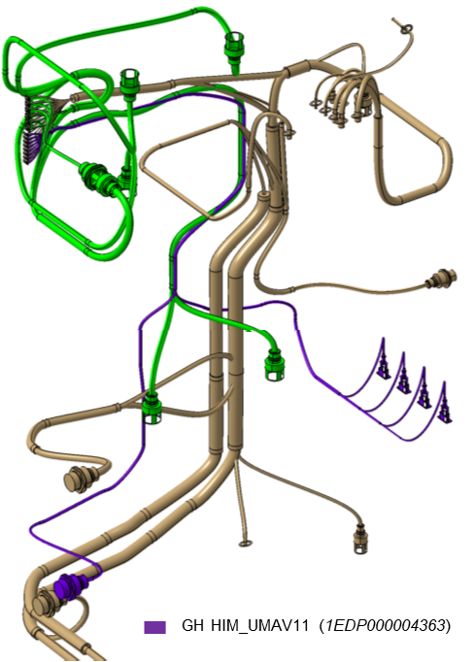
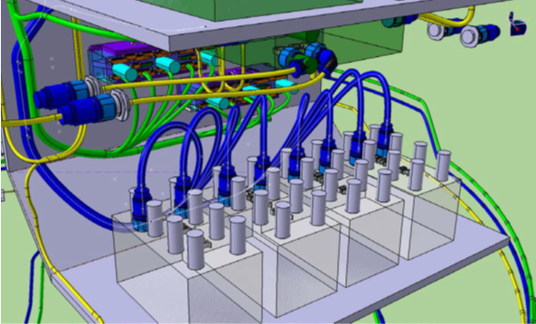
PART 2: AVIONICS BAY POWER HARNESS DESIGN
-

Slide 13
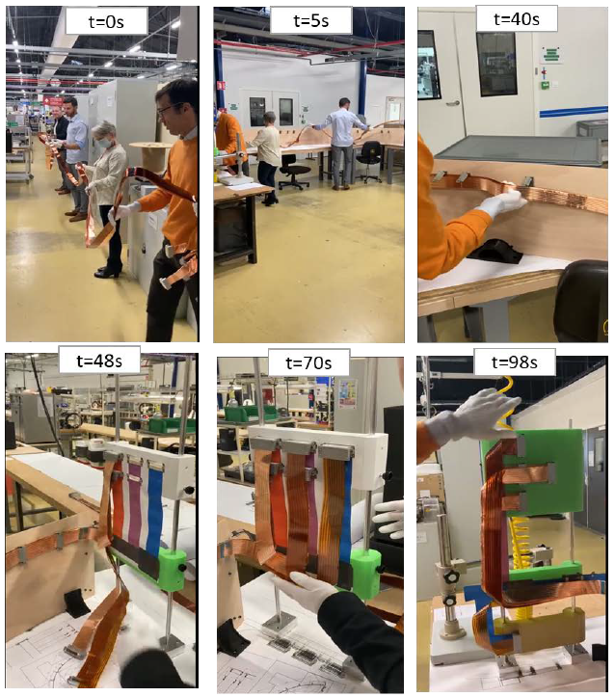
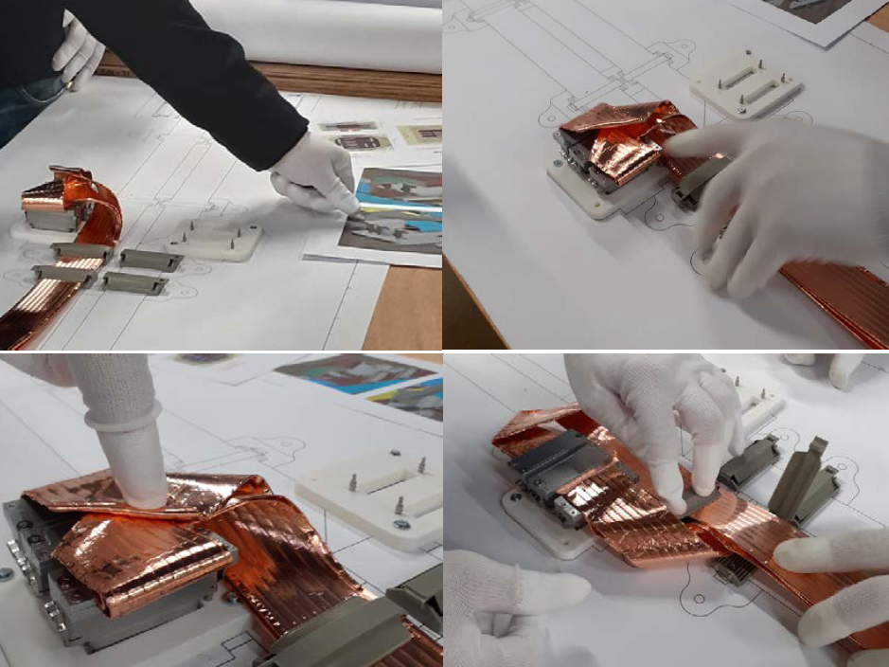
PART 3: INTERTANK Manufacturing…and integration
-

Slide 14
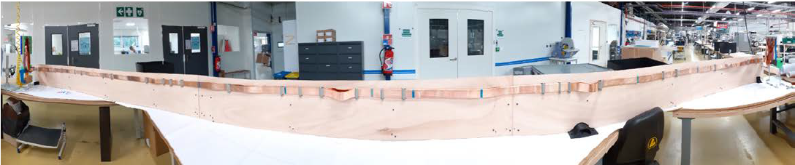
PART 3: INTERTANK Manufacturing…and integration
-

Slide 15
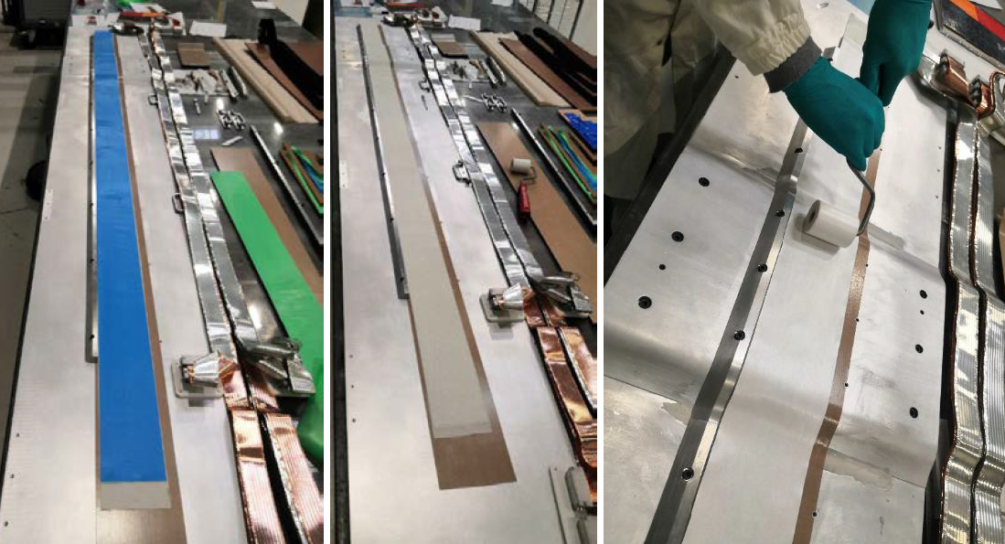
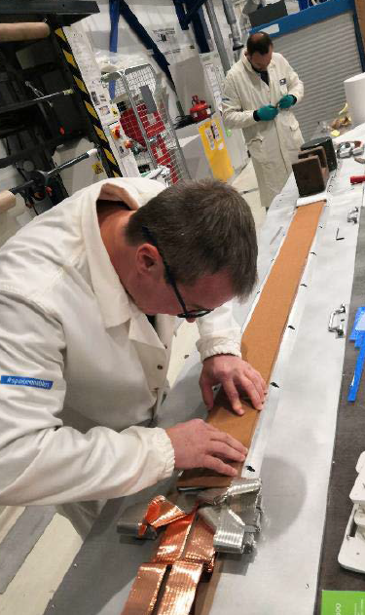
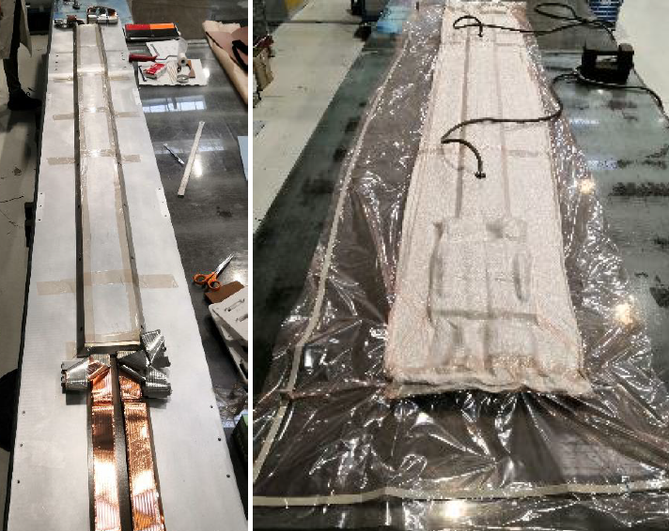
PART 3: EXTERNAL RACEWAY MANUFACTURING
-

Slide 16
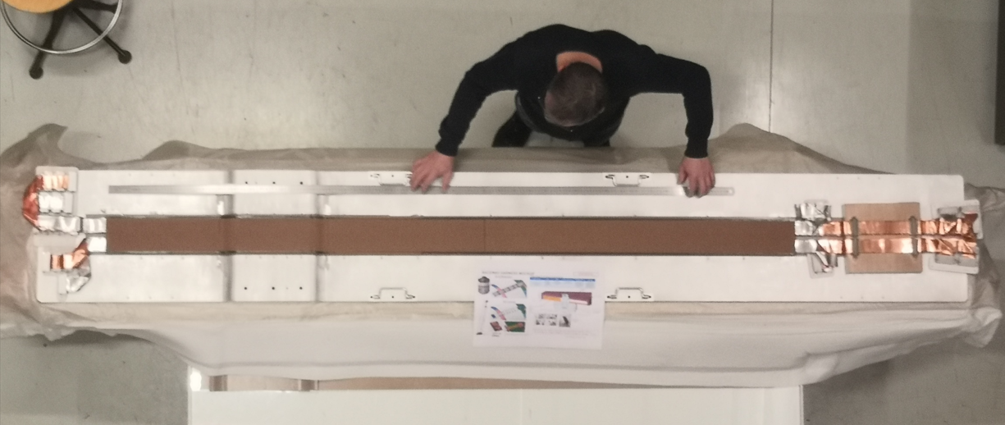
PART 3: EXTERNAL RACEWAY MANUFACTURING
-

Slide 17
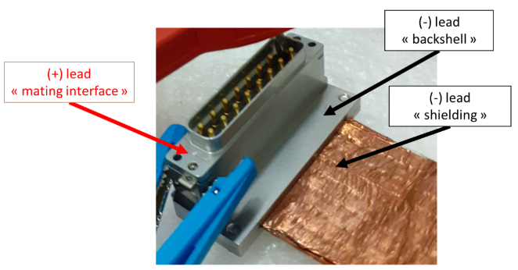
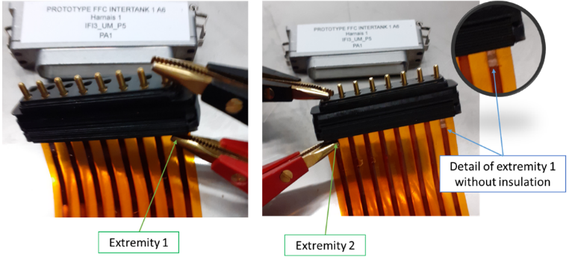
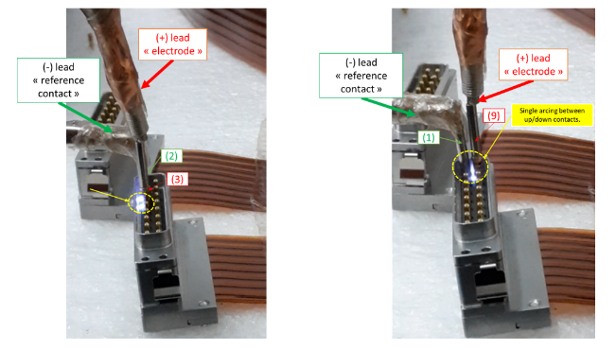
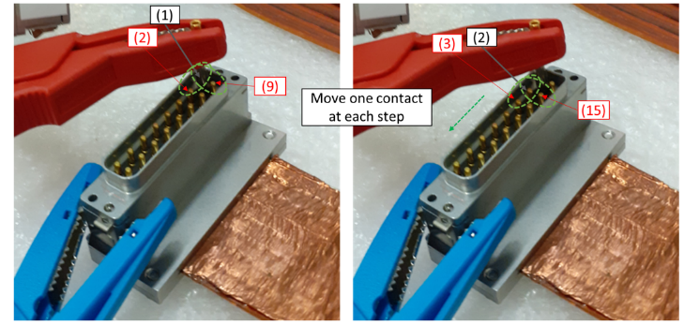
PART 3: ELECTRICAL TESTING
Contact (pin)/conductor resistance
Backshell/Shielding resistance
Insulation resistance
Voltage Insulation withstanding
-

Slide 18
PART 4: CONCLUSIONS (I)
Potential of Flat Flexible Cable technologies to be used in different Space/Launcher applications is proven
Key enablers developed:
  Flat Cable and associated connector to build is now available.
  Design process.
  Composite embedding technology for harsh environments.
-

Slide 19
PART 4: CONCLUSIONS (II) & PERSPECTIVES
Flat Flexible cables make:
  Design process easier.
  Manufacturing straightforward.
  Integration simplified.
  Test and troubleshooting easier.
  Reduce volume allocation(>70%)
  Reduce mass (>30%)
  PERSPECTIVES
  Enhance technology maturity.
  Further Verify electrical features (shielding, coupling).
-

Slide 20
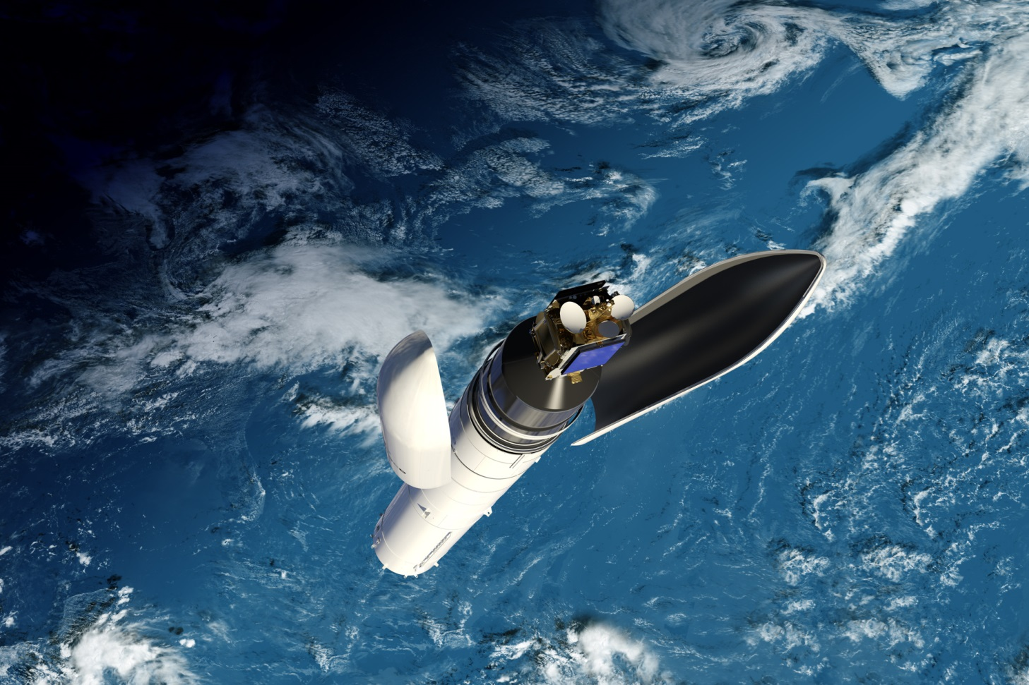
Thank you !
Questions?
Let’s make it fly !
-

